Slide 1
Chapter 5
Digital Filter Structures

Slide 2
§5.1 Introduction
The actual implementation of an LTI digital filter can be either in software or hardware form, depending on applications
In either case, the signal variables and the filter coefficients cannot be represented with finite precision

Slide 3
§5.1 Introduction
A structural representation using interconnected basic building blocks is the first step in the hardware or software implementation of an LTI digital filter
The structural representation provides the key relations between some pertinent internal variables with the input and output that in turn provides the key to the implementation

Slide 4
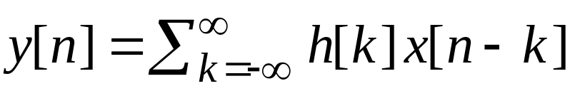
§5.1.1 Block Diagram Representation
In the time domain, the input-output relations of an LTI digital filter is given by the convolution sum
FIR DF
or, by the linear constant coefficient difference equation
IIR DF

Slide 5
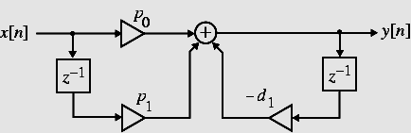
§5.1.1 Block Diagram Representation
For the implementation of an LTI digital filter, the input-output relationship must be described by a valid computational algorithm
To illustrate what we mean by a computational algorithm, consider the causal first-order LTI digital filter shown below

Slide 6
§5.1.1 Block Diagram Representation
The filter is described by the difference equation
y[n]=-d₁y[n-1]+p₀x[n]+p₁x[n-1]
Using the above equation we can compute y[n] for n≥0 knowing the initial condition y[n-1] and the input x[n] for
n ≥-1

Slide 7
§5.1.1 Block Diagram Representation
y[0]=-d₁y[-1]+p₀x[0]+p₁x[-1]
y[1]=-d₁y[0]+p₀x[1]+p₁x[0]
y[2]=-d₁y[1]+p₀x[2]+p₁x[1]
.…
We can continue this calculation for any value of the time index n we desire

Slide 8
§5.1.1 Block Diagram Representation
Each step of the calculation requires a knowledge of the previously calculated value of the output sample (delayed value of the output), the present value of the input sample, and the previous value of the input sample (delayed value of the input)
As a result, the first-order difference equation can be interpreted as a valid computational algorithm

Slide 9


§5.1.2 Basic Building Blocks
The computational algorithm of an LTI digital filter can be conveniently represented in block diagram form using the basic building blocks shown below
A
x[n]
y[n]
y[n]
x[n]
w[n]
Multiplier
Adder
x[n]
x[n]
x[n]
y[n]
x[n]
Unit delay
Pick-off node

Slide 10
§5.1.2 Basic Building Blocks
Advantages of block diagram representation
(1) Easy to write down the computational algorithm by inspection
Easy to analyze the block diagram to determine the explicit relation between the output and input
Easy to manipulate a block diagram to derive other “equivalent” block diagrams yielding different computational algorithms
Easy to determine the hardware requirements
Easier to develop block diagram representations from the transfer function directly

Slide 11
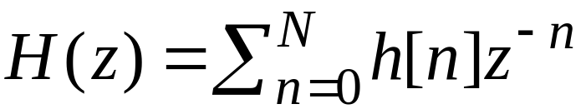
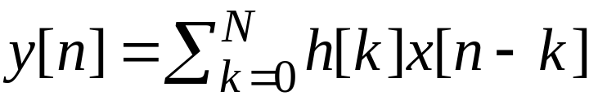
§5.2 Basic FIR Digital Filter Structures
A causal FIR filter of order N is characterized by a transfer function H(z) given by
which is a polynomial in z⁻¹
In the time-domain the input-output relation of the above FIR filter is given by

Slide 12
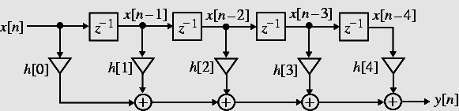
§5.2 Basic FIR Digital Filter Structures
A direct form realization of an FIR filter can be readily developed from the convolution sum description as indicated below for N = 4

Slide 13
§5.2 Basic FIR Digital Filter Structures
An analysis of this structure yields
which is precisely of the form of the convolution sum description
The direct form structure shown on the previous slide is also known as a tapped delay line or a transversal filter

Slide 14
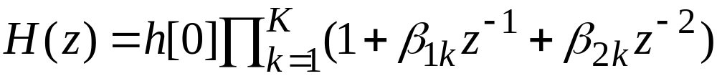
§5.2.1 Cascade Form FIR Digital
Filter Structures
A higher-order FIR transfer function can also be realized as a cascade of second-order FIR sections and possibly a first-order section
To this end we express H(z) as
where k=N/2 if N is even, and k=(N+1)/2 if N is odd, with β_{2k}=0

Slide 15
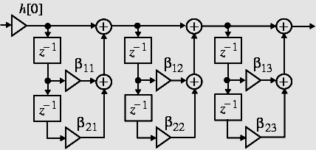
§5.2.1 Cascade Form FIR Digital
Filter Structures
A cascade realization for N = 6 is shown below
Each second-order section in the above structure can also be realized in the transposed direct form

Slide 16
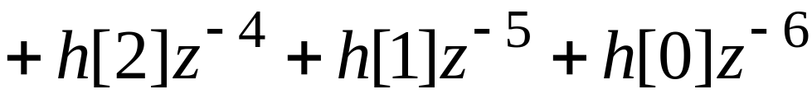
§5.2.2 Linear-Phase FIR Structures
The symmetry (or antisymmetry) property of a linear-phase FIR filter can be exploited to reduce the number of multipliers into almost half of that in the direct form implementations
Consider a length-7 Type 1 FIR transfer function with a symmetric impulse response

Slide 17
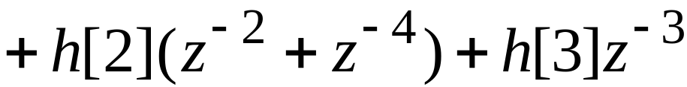
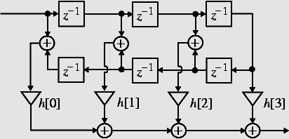
§5.2.2 Linear-Phase FIR Structures
Rewriting H(z) in the form
we obtain the realization shown below

Slide 18
§5.2.2 Linear-Phase FIR Structures
A similar decomposition can be applied to a Type 2 FIR transfer function
For example, a length-8 Type 2 FIR transfer function can be expressed as
The corresponding realization is shown on the next slide

Slide 19
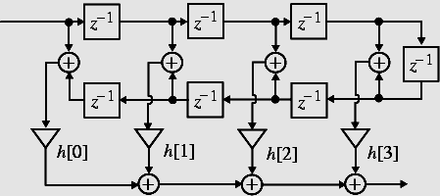
§5.2.2 Linear-Phase FIR Structures
Note: The Type 1 linear-phase structure for a length-7 FIR filter requires 4 multipliers, whereas a direct form realization requires 7 multipliers

Slide 20
§5.2.2 Linear-Phase FIR Structures
Note: The Type 2 linear-phase structure for a length-8 FIR filter requires 4 multipliers, whereas a direct form realization requires 8 multipliers
Similar savings occurs in the realization of Type 3 and Type 4 linear-phase FIR filters with antisymmetric impulse responses

Slide 21
§5.2.2 Basic IIR Digital Filter
Structures
The causal IIR digital filters we are concerned with in this course are characterized by a real rational transfer function of z⁻¹ or, equivalently by a constant coefficient difference equation
From the difference equation representation, it can be seen that the realization of the causal IIR digital filters requires some form of feedback

Slide 22
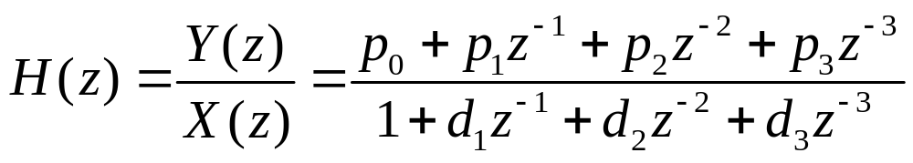
§5.3 Basic IIR Digital Filter
Structures
Direct form IIR filters: Filter structures in which the multiplier coefficients are precisely the coefficients of the transfer function
Consider for simplicity a 3rd-order IIR filter with a transfer function
We can implement H(z) as a cascade of two filter sections as shown on the next slide

Slide 23
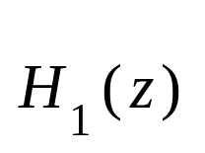




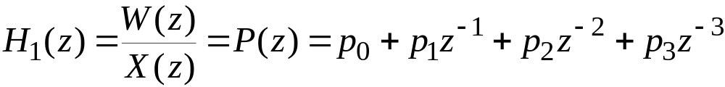
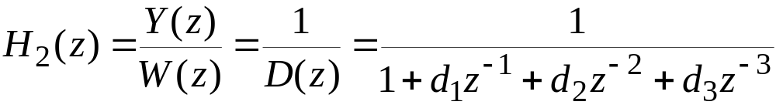
§5.3 Direct Form IIR Digital Filter
Structures

Slide 24
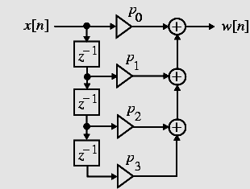
§5.3.1 Direct Form IIR Digital Filter
Structures
The filter section H₁(z) can be seen to be an FIR filter and can be realized as shown right

Slide 25
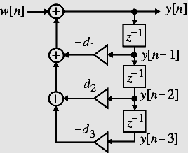
§5.3.1 Direct Form IIR Digital Filter
Structures
The time-domain representation of H₂(z) is given by
Realization of follows from the above equation and is shown on the right

Slide 26
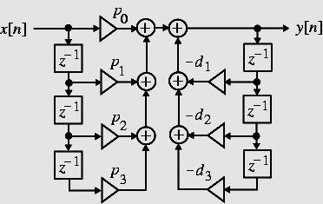
§5.3.1 Direct Form IIR Digital Filter
Structures
A cascade of the two structures realizing H₁(z) and H₂(z) leads to the realization of H(z) shown below and is known as the Direct Form I structure

Slide 27
§5.3.1 Direct Form IIR Digital Filter
Structures
Note: The direct form I structure is noncanonic as it employs 6 delays to realize a 3rd-order transfer function

Slide 28
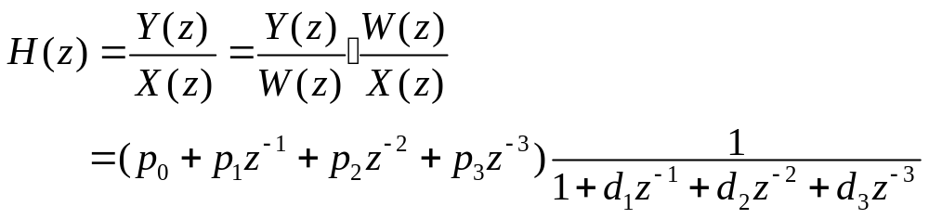
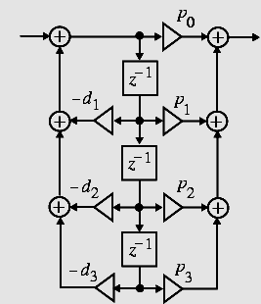



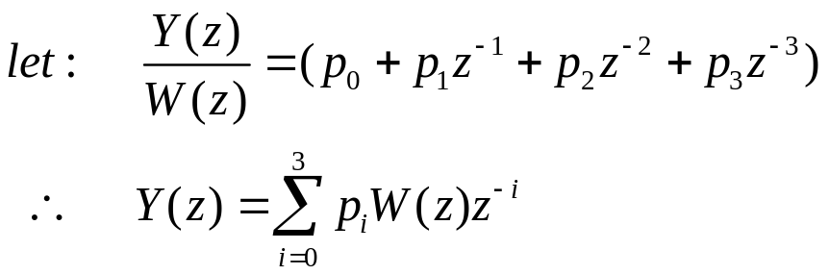
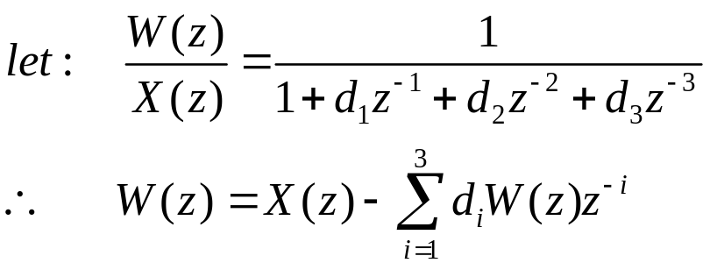
§5.3.1 Direct Form IIR Digital Filter
Structures
Direct form realizations of an N-th order IIR transfer function should be evident

Slide 29
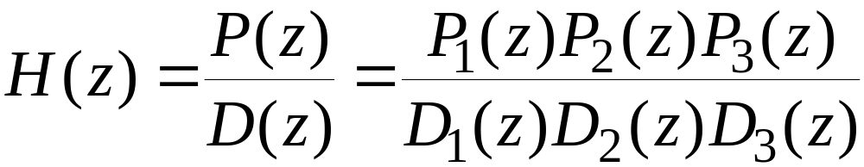
§5.3.1 Cascade Form IIR Digital Filter
Structures
By expressing the numerator and the denominator polynomials of the transfer function as a product of polynomials of lower degree, a digital filter can be realized as a cascade of low-order filter sections
Consider, for example, H(z) = P(z)/D(z) expressed as

Slide 30
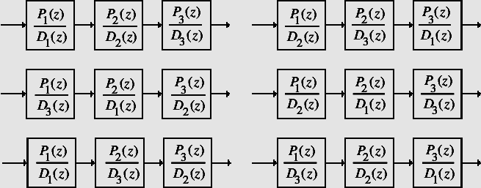
§5.3.2 Cascade Form IIR Digital
Filter Structures
Examples of cascade realizations obtained by different pole-zero pairings are shown below

Slide 31
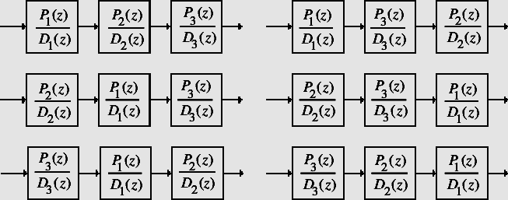
§5.3.2 Cascade Form IIR Digital
Filter Structures
Examples of cascade realizations obtained by different ordering of sections are shown below

Slide 32
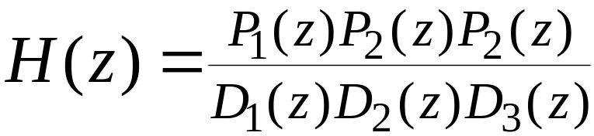
§5.3.2 Cascade Form IIR Digital Filter Structures
There are altogether a total of 36 different cascade realizations of
based on pole-zero-pairings and ordering
Due to finite wordlength effects, each such cascade realization behaves differently from others

Slide 33
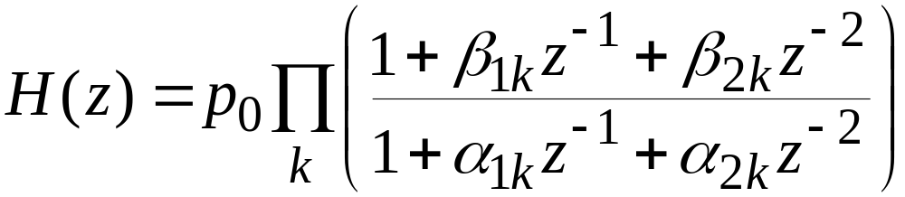
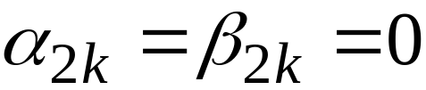
§5.3.2 Cascade Form IIR Digital Filter Structures
Usually, the polynomials are factored into a product of 1st-order and 2nd-order polynomials:
In the above, for a first-order factor

Slide 34
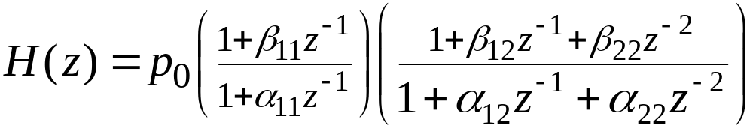
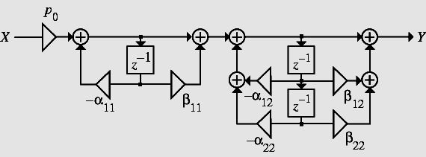
§5.3.2 Cascade Form IIR Digital Filter Structures
Consider the 3rd-order transfer function
One possible realization is shown below

Slide 35
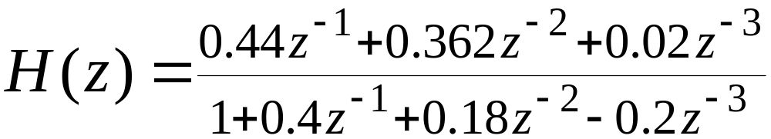
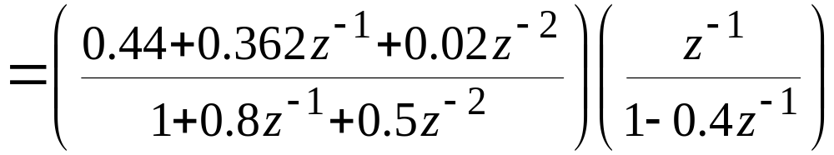
§5.3.2 Cascade Form IIR Digital Filter
Structures
Example - Direct form II and cascade form realizations of
are shown on the next slide.

Slide 36
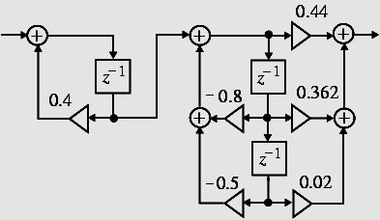
§5.3.2 Cascade Form IIR Digital Filter
Structures
Cascade form

Slide 37
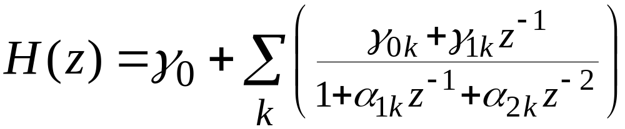

§5.3.2 Parallel Form IIR Digital Filter Structures
A partial-fraction expansion of the transfer function in z⁻¹ leads to the parallel form I structure
Assuming simple poles, the transfer function H(z) can be expressed as
In the above for a real pole

Slide 38
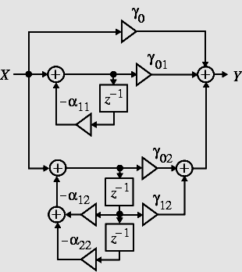
§5.3.2 Parallel Form IIR Digital Filter
Structures
The basic parallel realizations of a 3rd-order IIR transfer function are shown below
Parallel form I

Slide 39
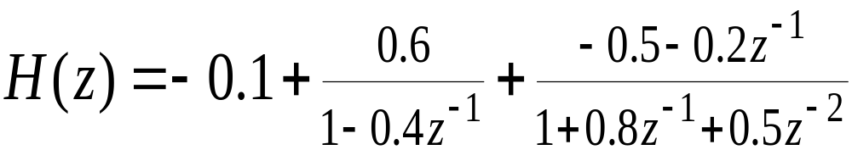
§5.3.2 Parallel Form IIR Digital Filter
Structures
Example - A partial-fraction expansion of
in z⁻¹ yields

Slide 40
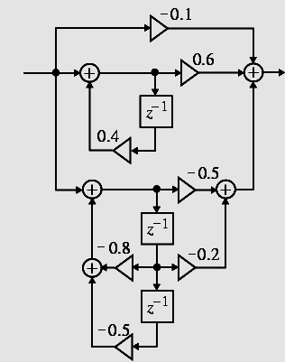
§5.3.2 Parallel Form IIR Digital Filter
Structures
The corresponding parallel form realization is shown right

